Slide 1
Erosion and Sedimentation

Slide 2
By the end of this Smart Lesson, you will be able to:
Define erosion and identify its agents.
Define sedimentation.
Distinguish weathering from erosion.
Describe how erosion and sedimentation work to shape the Earth’s surface.

Slide 3
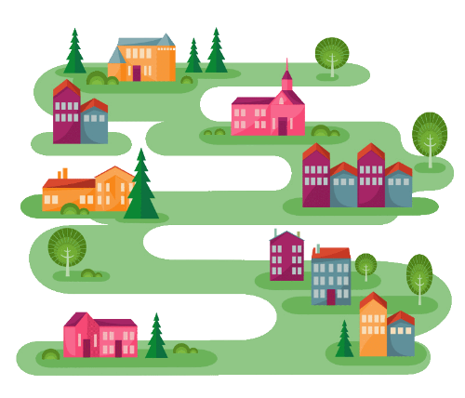
Where does this lesson lie on our geological roadmap?
Weathering is the geological process that leads up to erosion and sedimentation. To recap very briefly, it is the breaking down of rock by natural processes such as rain or ice.
The processes of erosion and sedimentation are also involved in forming sedimentary rocks.

Slide 4
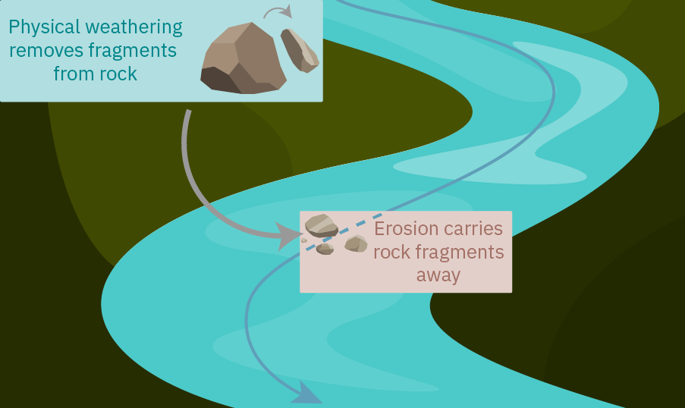
Let’s get started with erosion.
After rocks have been broken down by weathering, their pieces are carried across the Earth's surface. This process is called erosion.
Weathering and erosion work together, but they are not the same thing! Weathering breaks down rocks, while erosion transports them.

Slide 5
We call these rock fragments sediment.
Sediment varies tremendously in size. An individual piece of sediment can be smaller than sand or larger than a boulder, and can feel as fine as silt or as rough as gravel.
No matter the size, texture or type of rock, all rock fragments are called sediment.

Slide 6
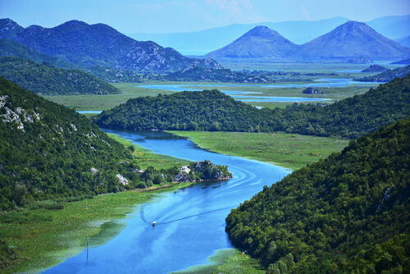
Anything that causes erosion is called an agent of erosion.
If it moves sediment across the Earth’s surface, it’s considered an agent of erosion.
Water is the most important agent of erosion. Strong river currents carry gravel and sand from the mountains high up to the lakes down low!

Slide 7
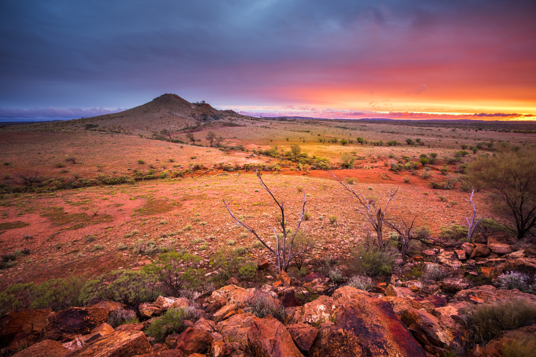
Another agent of erosion is wind.
Wind carries small and light particles of sediment. The Australian outback, shown below, experiences dry desert winds that carry sand all the way to the ocean.

Slide 8
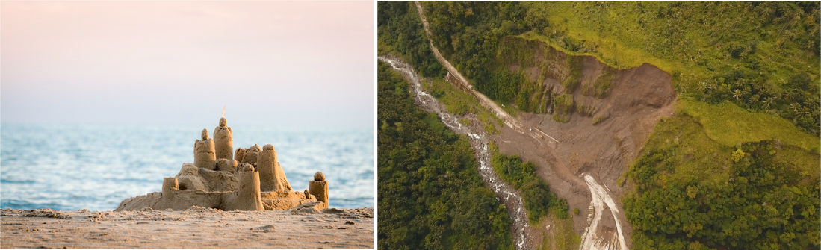
Gravity is a powerful and fearsome agent of erosion.
Gravity is the force that literally keeps us grounded. This means that it brings sediment downhill. Have you ever seen a sandcastle fall apart? Its collapse was most likely caused by gravity.
Now imagine that on a much larger scale. When large amounts of sediment erode because of gravity, we call it a landslide. Gravity is strong enough to bring down boulders!

Slide 9
All of the agents of erosion we’ve just mentioned—water, wind and gravity—are much more powerful in places at high altitudes. These places are more exposed to wind, and both river currents and gravity can carry things much further.
The rocks that make up mountains are gradually eroded away. Some mountainous ranges, like the Southern Alps of New Zealand, are eroded just as rapidly as they are built up!
Flat regions, as in plains and deserts, do not experience erosion to nearly the same extent.

Slide 10
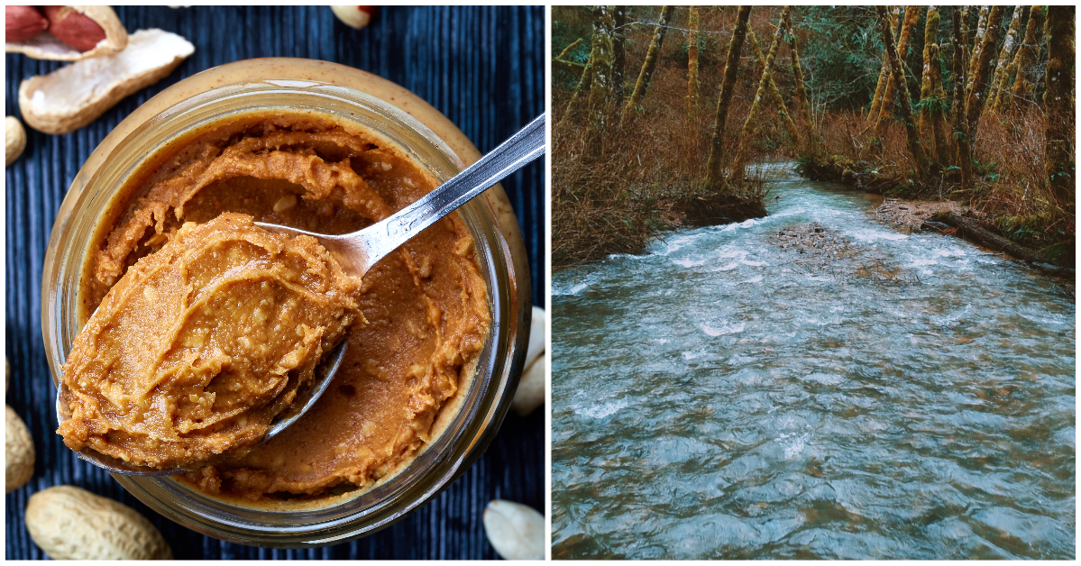
So where does all that sediment go?
All sediment is deposited (dumped) somewhere on Earth's surface. This is the process of sedimentation, also known as deposition.
It most commonly happens in bodies of water, where the water current slows down. Often, this happens in river bends, or in places where the landscape changes from a slope to a flat plain.

Slide 11
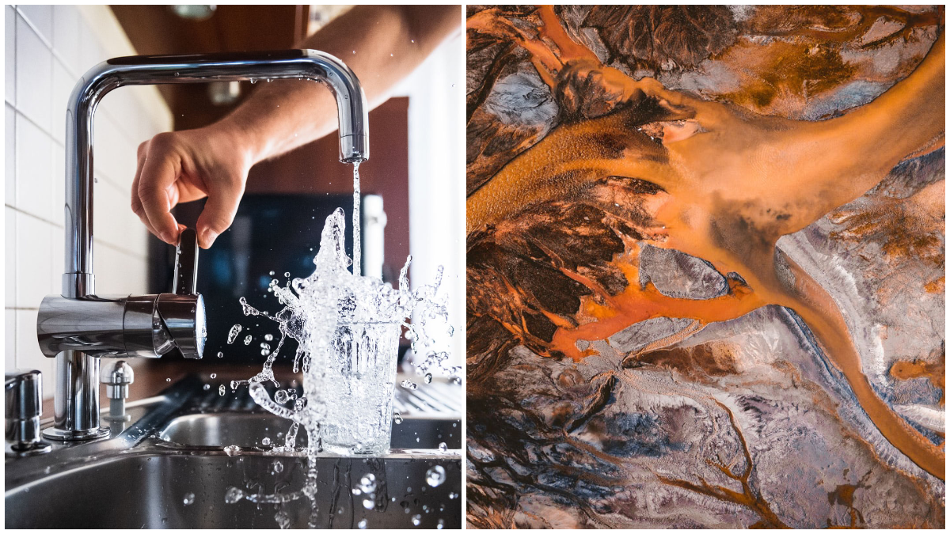
Sedimentation usually happens underwater.
Sedimentation is a common occurrence in lakes, oceans or rivers. It is the process of sediment building up in a particular area over time. While sedimentation does happen elsewhere, like in deserts, we'll focus mostly on these bodies of water.

Slide 12
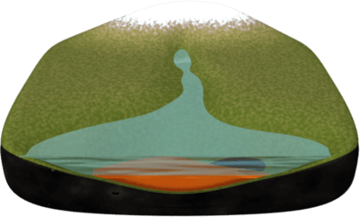
Different types of sediment are deposited in different areas.
It comes down to how large the sediment is. Small particles of sediment are light and do not need a strong current to carry them, so they can travel very far. They typically only settle in places where the current is very weak.
In lakes, where there is little to no current, very small particles such as silt and clay are deposited at the lake bottom, forming mud.

Slide 13
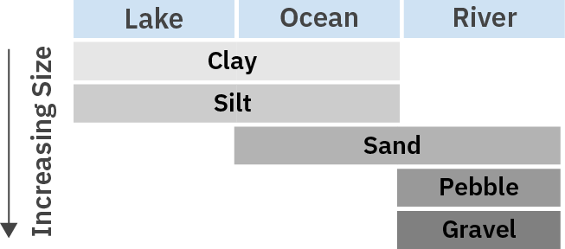
We’ve just introduced a bunch of different terms to describe sediment:
Gravel, pebbles, sand, silt, clay, mud.
These are the main types of sediment that are formed by weathering and erosion. To recap, this chart sorts each type of sediment by their common locations.

